Slide 2
The Choice

Slide 3
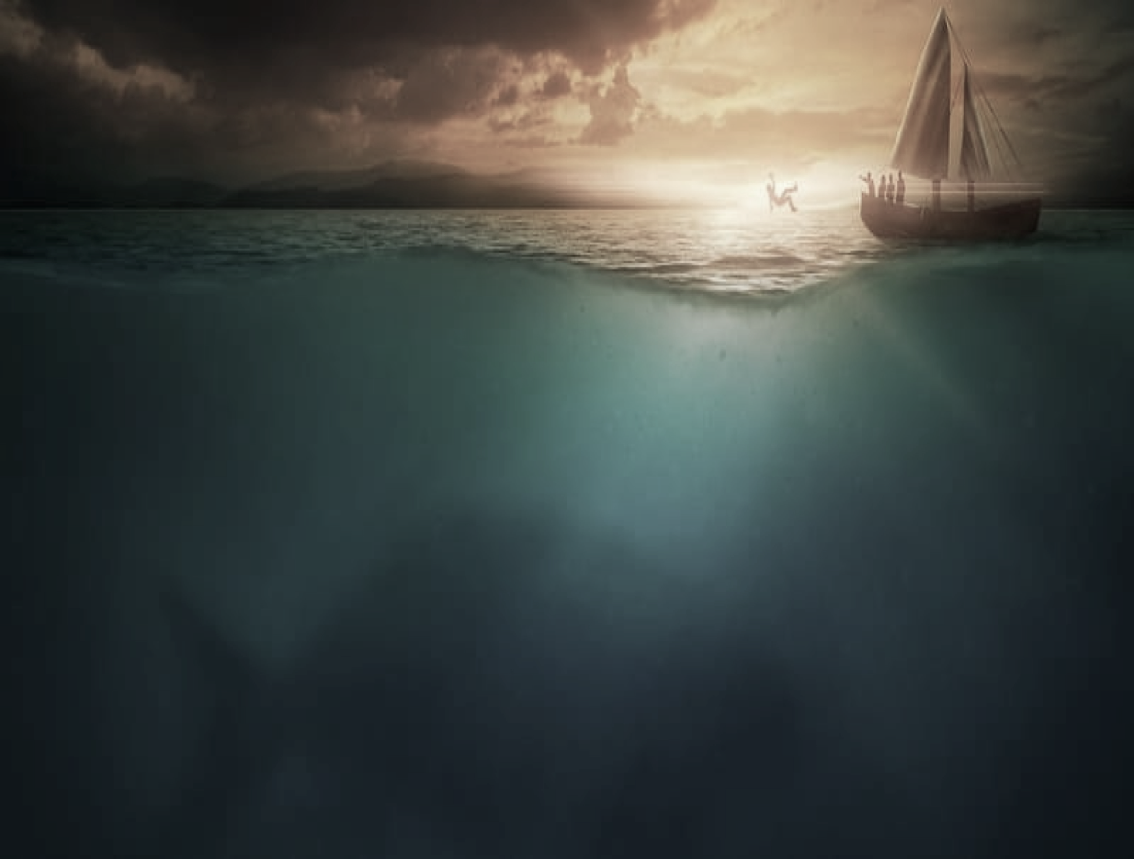
The Call (1:1-3)
Ninevah- Capital of Assyria- world power
Why did he not want to go to Ninevah?
Ninevah- arch enemies of Israel
Cruel, blood thirsty people
Prophesied to bring Israel into captivity
Jonah did not like these people
Are we sometimes like Jonah?

Slide 4
God’s Corrective Hand (1:4-6)
Vs. 4- “But the Lord”
Satan uses things to pull us away- (Gal. 5:19-21)
God uses things to pull us in- (Heb. 12:3-7)
Often, we are like Jonah!

Slide 5
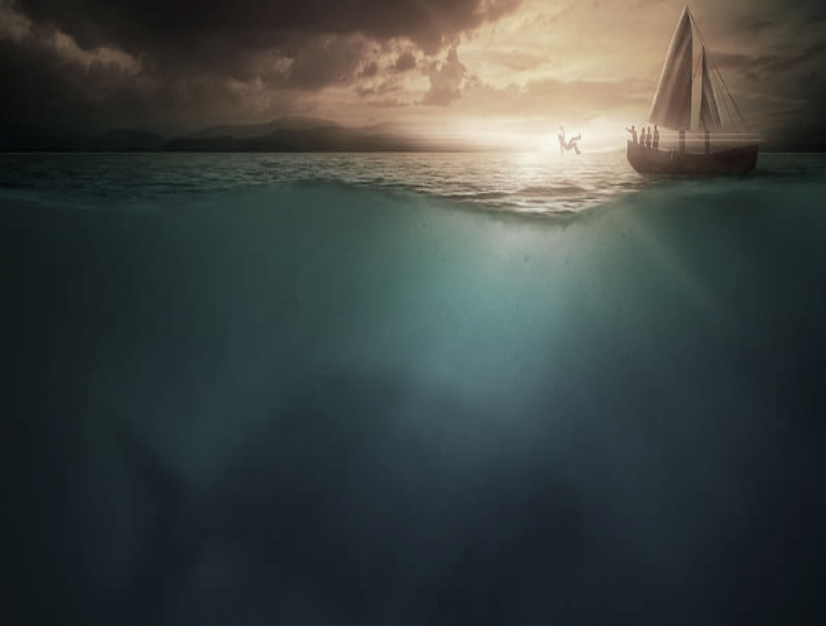
Stubborn against God (1:7-16)
The storm is going to kill everyone on board
Jonah’s solution- throw me overboard
No prayer, no repentance, no confessing
Are we just as stubborn?
Maybe we need to, “Throw our Jonah’s overboard”

