Slide 2


Slide 3
Preaching Jesus
Acts 8:26-39

Slide 4

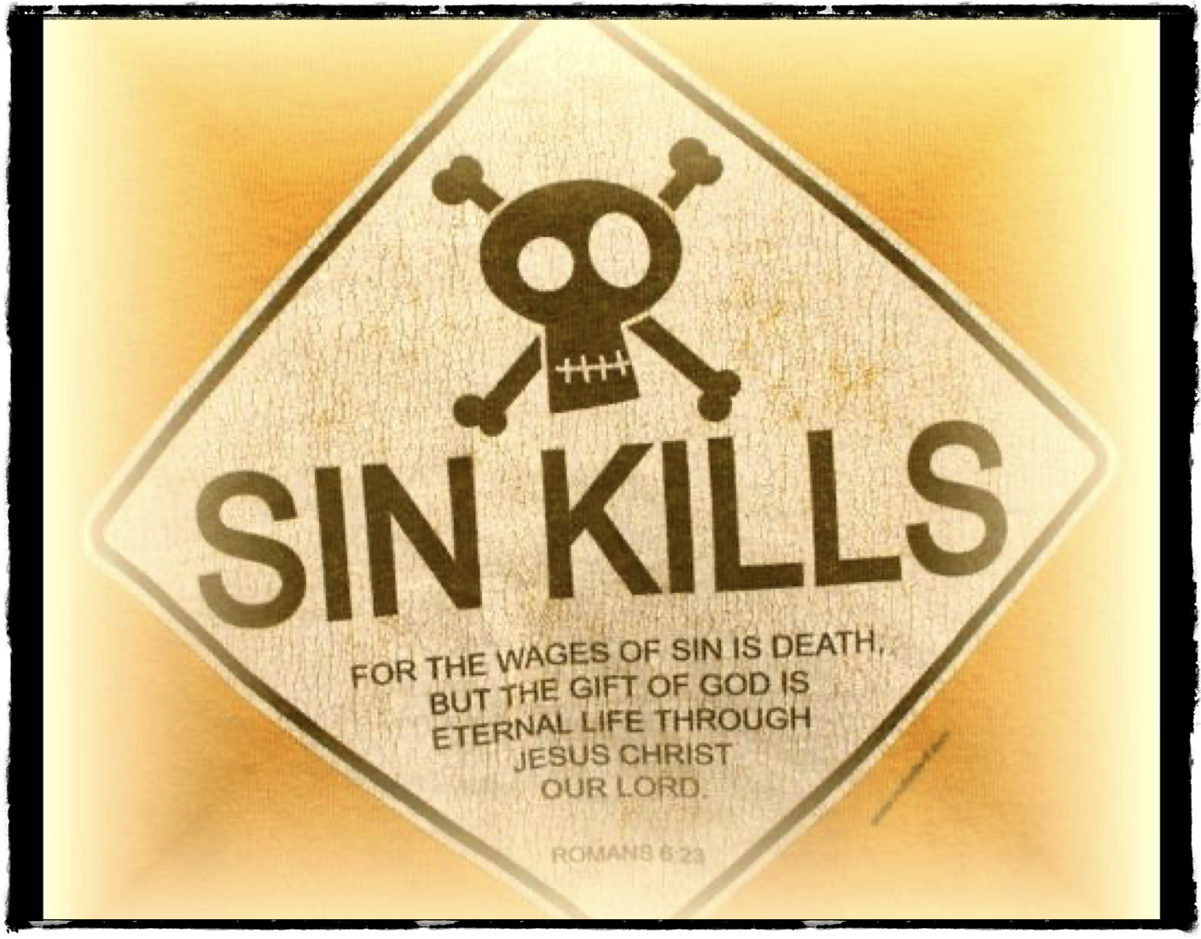
The Reality of Sin
“Sin” is not politically correct today
We all have sinned! Isaiah 53:6, Romans 3:9-18, 23
We deserve death- Romans 6:23

Slide 5

God’s Love for Sinners
God’s unconditional love-
Romans 6:23, John 3:16
Not just for those who love him and serve him
Jesus died for ALL of us!

Slide 6

God’s Hatred for Sin
God’s love is NOT a tolerance for sin
Evident throughout history
  Adam & Eve
  2 Peter 2:6- Sodom & Gomorrah
  Acts 5:1-11- Ananias & Sapphira

Slide 7

The Necessity of Obedience
Philippians 2:5-8- Jesus was obedient
Matt. 7:21-23-We must be obedient
Revelation 2:10

