Slide 1
Laughing with the Scriptures
Ecclesiastes 3:1, 4

Slide 2
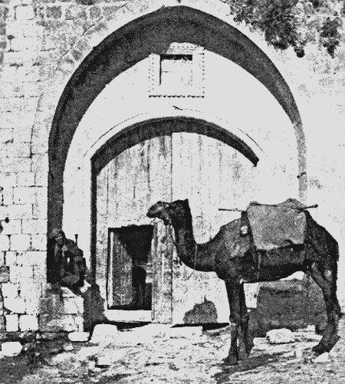
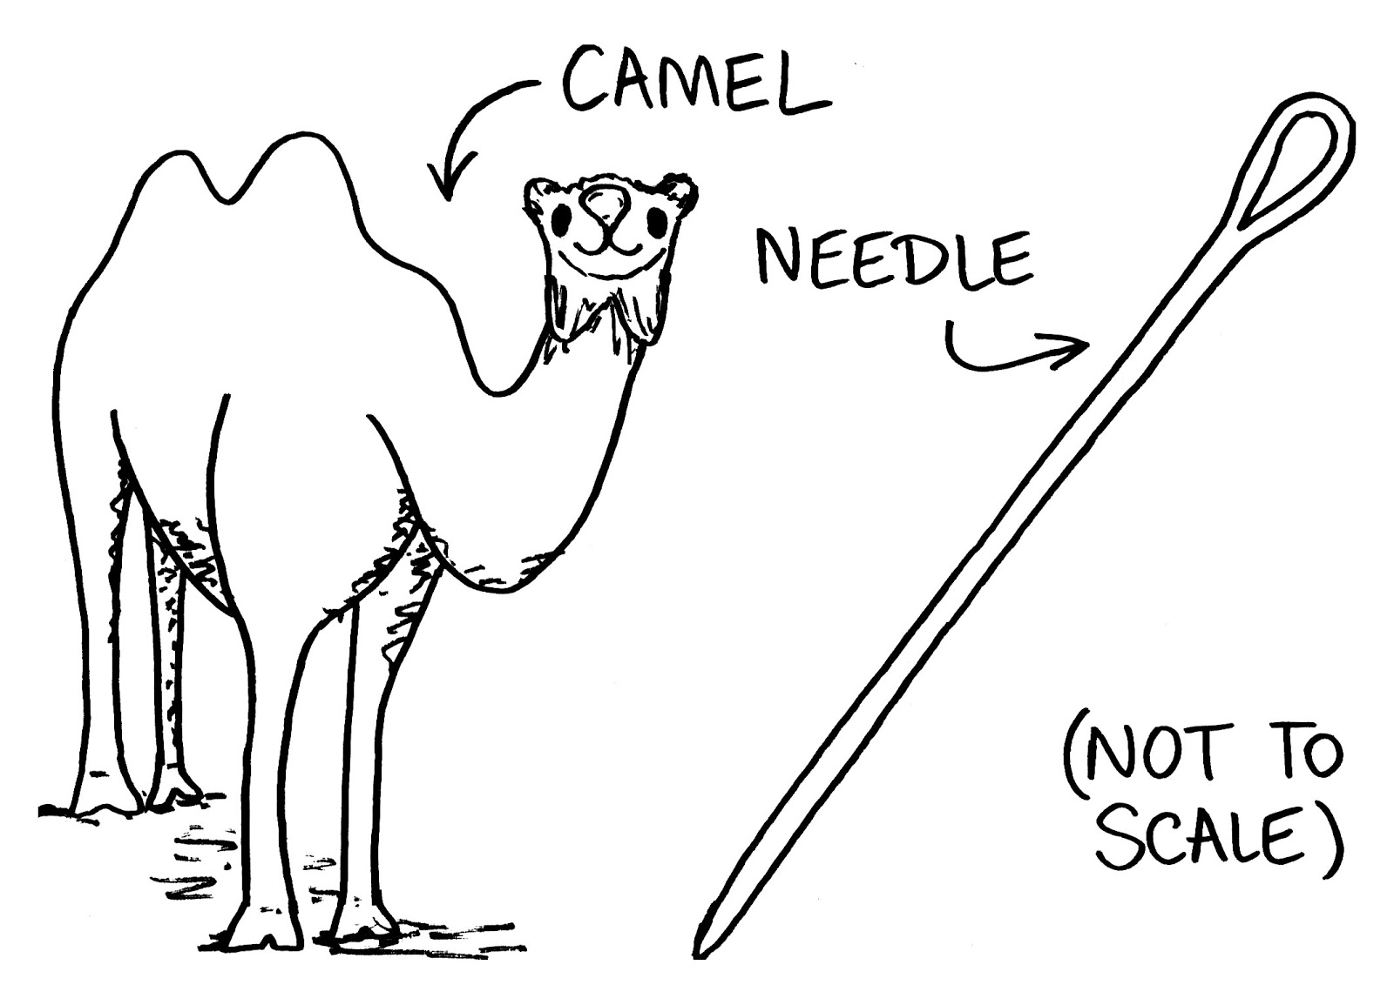
Laughter is part of the human experience
There is a time for everything (Ecclesiastes 3:1-8).
Have we removed laughter from God, from the Scriptures, from ourselves?
Humor is part of the story (Gen 21:1-7)!
Peter used humor (Acts 2:15).
Paul used humor (Philemon 17-22).
Jesus used humor (Luke 11:11-15).

Slide 3
Parts of the Scriptures are funny
Irony
Jacob
Haman
Sadducees
Rhoda

Slide 4
Parts of the Scriptures are funny
Wordplay
People names
Place names
Cut off from Christ (Gal 5:4, 12)

Slide 5
Parts of the Scriptures are funny
Imagery
Beams & specks (Matt 7:3-5, Luke 6:41-42)
Swallowing a camel (Matt 23:24)
Eye of the needle (Matt 19:24, Mark 10:25, Luke 18:25)
Abundance of meat (Num 11:18-20)
Futile labor (Isa 26:18)

Slide 6
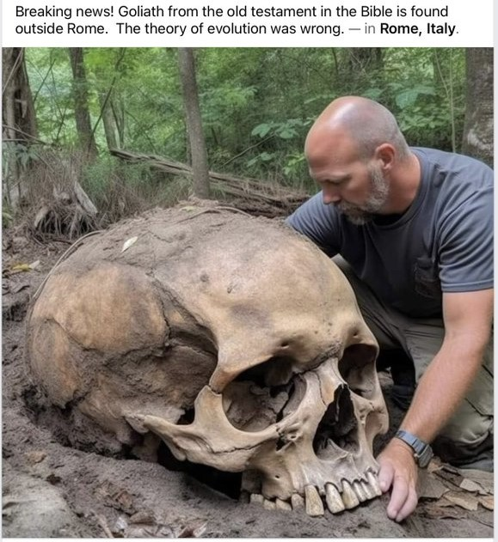
We will be laughed at, but why?
Because we are fools?
1 Sam 25:25
Titus 1:12-13
Because of the cross and the resurrection?
Matt 27:27-31
1 Cor 1:18-25
Acts 17:30-34

