Slide 1
What are problems facing the church today?

Slide 2

Just Too Busy
To be a family

Slide 3

Love and Respect
Ephesians 5:22-23
The love and respect connection
The husbands ultimate need is respect and the wife’s ultimate need is love

Slide 4



Slide 5

Husbands- are we too busy to fulfill our obligations to our wife?
C-O-U-P-L-E
  Closeness
  Openness
  Understanding
  Peacemaking
  Loyalty
  Esteem

Slide 6
Wives- are we too busy to fulfill our obligations to our Husband?
C-H-A-I-R-S
  Conquest
  Hierarchy
  Authority
  Insight
  Relationship
  Sexuality

Slide 7
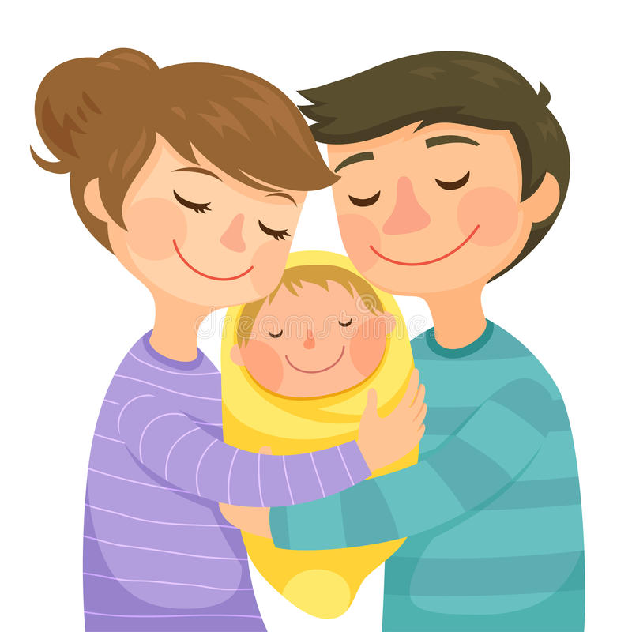
Parents- are we too busy to fulfill our obligations to our children?
Many responsibilities cannot be fulfilled without spending time together
Children learn from what they see
Training young people requires high standards

