Slide 1
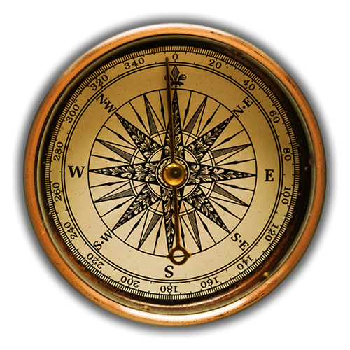
Navigating God’s Narrow, Straight Path To Heaven
"Enter by the narrow gate. For the gate is wide and the way is easy (broad) that leads to destruction, and those who enter by it are many. For the gate is narrow and the way is hard that leads to life, and those who find it are few. .”
- Matthew 7:13-14

Slide 2
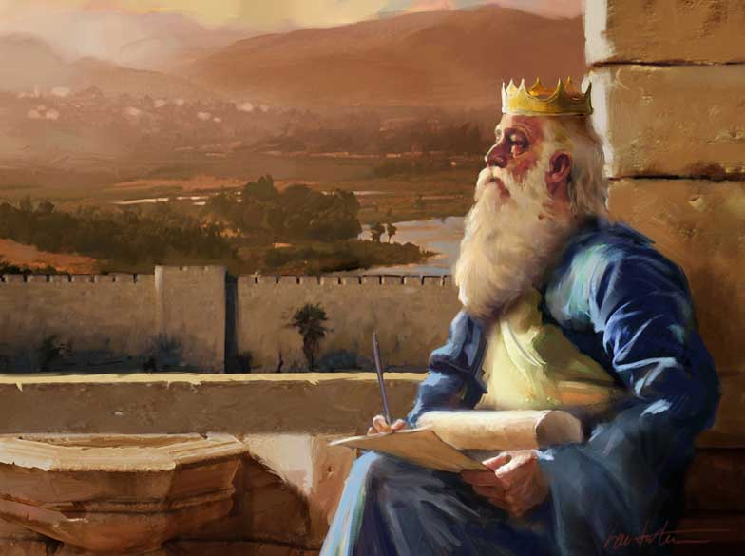
King David’s
Final Words To Solomon
"I am about to go the way of all the earth. Be strong, and show yourself a man, and keep the charge of the Lord your God, walking in his ways and keeping his statutes, his commandments, his rules, and his testimonies, as it is written in the Law of Moses, that you may prosper in all that you do and wherever you turn.”
- 1 Kings 2:2-3

Slide 3
We Need Instruction To Find The Right Way
We Must Be Willing To Look Outside Of Ourselves To Find The Right Way
1 Samuel 12:23 “Moreover, as for me, far be it from me that I should sin against the Lord by ceasing to pray for you, and I will instruct you in the good and the right way.”
Acts 20:20
“How I did not shrink from declaring to you anything that was profitable, and teaching you in public and from house to house.”
Navigating God’s Narrow,
Straight Path To Heaven

Slide 4
We Can’t Find The Right Way On Our Own
We must learn to trust God because we will never have full understanding
Jeremiah 10:23
“I know, O Lord, that a man's way is not in himself; Nor is it in a man who walks to direct his steps.”
Proverbs 20:24
“A man's steps are from the Lord; how then can man understand his way?”
Navigating God’s Narrow,
Straight Path To Heaven

Slide 5
Pursuing Your Way Is The Way Of Death
Frank Sinatra’s Song “I Did It My Way”
But “My Way”
Is The WRONG Way!
Proverbs 14:12
“There is a way that seems right to a man, but its end is the way to death.”
Psalm 119:27
“Make me understand the way of your precepts, and I will meditate on your wondrous works.”
Navigating God’s Narrow,
Straight Path To Heaven

Slide 6
Have You Forsaken The Right Way?
To Forsake Something Means to Reject or Disown. That is Terrible Thing To Do To God & Jesus
2 Peter 2:15
“Forsaking the right way, they have gone astray. They have followed the way of Balaam, the son of Beor, who loved gain from wrongdoing.”
Proverbs 28:4
“Those who forsake the law praise the wicked, but those who keep the law strive against them.”
Navigating God’s Narrow,
Straight Path To Heaven

Slide 7
The Right Way Is Usually The Hard Way?
The WAY To LIFE
Is Hard, Difficult, Challenging!
The WAY To DESTRUCTION Is Easy, Smooth, Effortless.
Matthew 7:13-14
"Enter by the narrow gate. For the gate is wide and the way is easy that leads to destruction, and those who enter by it are many. For the gate is narrow and the way is hard that leads to life, and those who find it are few. .”
Navigating God’s Narrow,
Straight Path To Heaven

Slide 8
Are You Travelling The Way Of Sinners?
Psalm 1:1
“Blessed is the man who walks not in the counsel of the wicked, nor stands in the way of sinners, nor sits in the seat of scoffers.”
Sinners Will Not Be Able To Help You Find The Right Way
Proverbs 4:14,19
“Do not enter the path of the wicked,
and do not walk in the way of the evil.”
“The way of the wicked is like deep darkness; they do not know over what they stumble.”
Navigating God’s Narrow,
Straight Path To Heaven

Slide 9
Jesus Knows The Right Way
The Word “Way” Means Road or Route. Thus, Jesus Knows The Way To God & Heaven!
John 14:6
“Jesus said to him, ‘I am the way, and the truth, and the life. No one comes to the Father except through me.’”
Acts 4:12
“And there is salvation in no one else, for there is no other name under heaven given among men by which we must be saved."
Navigating God’s Narrow,
Straight Path To Heaven

Slide 10
“The Way” Of The First Century Christians
The Word “Way” Was Used Several Times In The Book of Acts To Describe Christ, His Gospel & Church.
Acts 19:9
“But when some became stubborn and continued in unbelief, speaking evil of the Way before the congregation…”
Acts 24:2
“But this I confess to you, that according to the Way, which they call a sect, I worship the God of our fathers…”
Navigating God’s Narrow,
Straight Path To Heaven

Slide 11
There’s Only ONE Road To Heaven!

