Slide 1
Navigating The Landscapes Of Life
Navigating The River of Time
Navigating The Mountaintops Of Success
Navigating The Hidden Rocks Of Fake Truth
Navigating The Valley Of Discouragement & Fear
Navigating Gods Narrow, Straight Path To Heaven

Slide 2
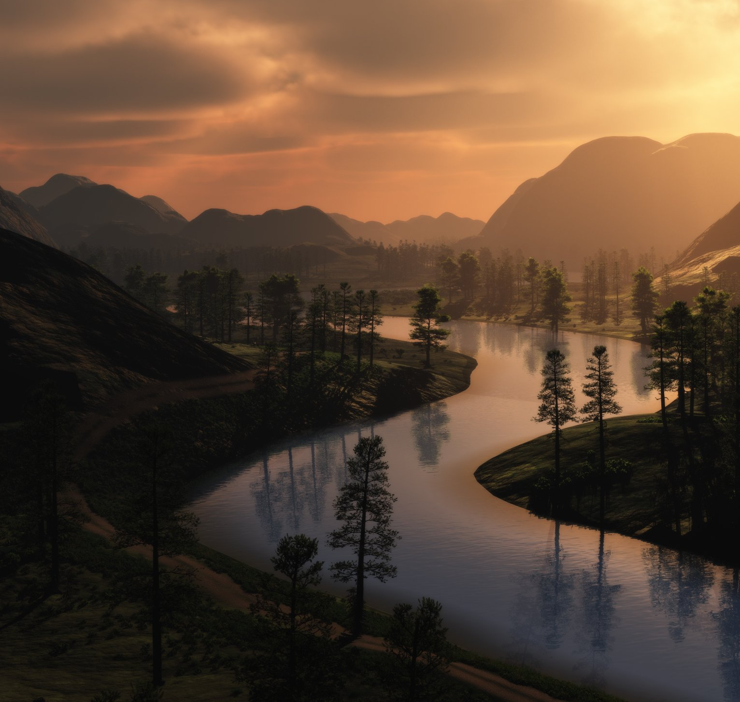
Navigating The River
Of Time
The word "time" appears 28 times in these eight verses, in 14 pairs of opposites,
Ecclesiastes 3:1-8

Slide 3
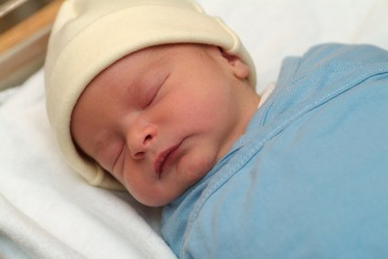
A Time To
Be Born
Jeremiah 1:4-5
“Now the word of the Lord came to me, saying, ‘Before I formed you in the womb I knew you, and before you were born I consecrated you;
I appointed you a prophet to the nations.’”
Isaiah 49:1
“Listen to me, O coastlands,
and give attention, you peoples from afar. The Lord called me from the womb, from the body of my mother he named my name.”
Ecclesiastes 3:2
Notes:
The great bookends of life: Our birth and death – which we have very little control over.

Slide 4
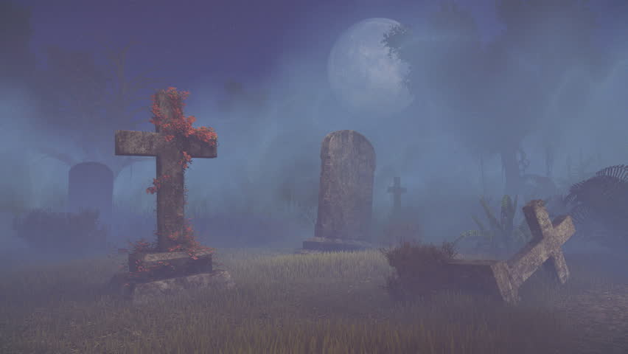
A Time To Die
Genesis 3:19
“By the sweat of your face
you shall eat bread, till you return to the ground, for out of it you were taken; for you are dust, and to dust you shall return."
Job 14:1-5
“Man, who is born of woman, Is short-lived and full of turmoil. Like a flower he comes forth and withers. He also flees like a shadow and does not remain. “You also open Your eyes on him And bring him into judgment with Yourself. Who can make the clean out of the unclean? No one! Since his days are determined, The number of his months is with You; And his limits You have set so that he cannot.”
Hebrews 9:27
“And just as it is appointed for man to die once, and after that comes judgment.”
Ecclesiastes 3:2

Slide 5
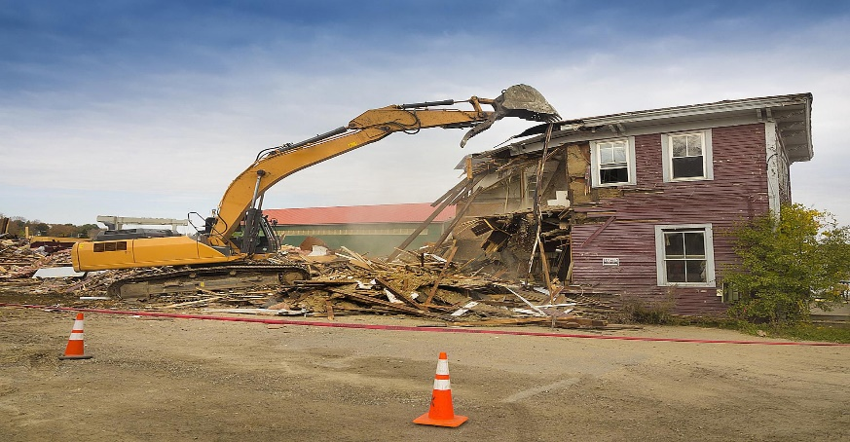
A Time To Tear Down
Contrition, Confession &
Repentance Is A Form Of Tearing Down.
“Be gracious to me, O God, according to Your lovingkindness; According to the greatness of Your compassion blot out my transgressions. Wash me thoroughly from my iniquity And cleanse me from my sin. For I know my transgressions, And my sin is ever before me. - Psalm 51:1-3
Revelation 13:1-3
"To the angel of the church in Sardis write: He who has the seven Spirits of God and the seven stars, says this: 'I know your deeds, that you have a name that you are alive, but you are dead. Wake up, and strengthen the things that remain, which were about to die; for I have not found your deeds completed in the sight of My God. So remember what you have received and heard; and keep it, and repent. Therefore if you do not wake up, I will come like a thief, and you will not know at what hour I will come to you.
Ecclesiastes 3:3

Slide 6
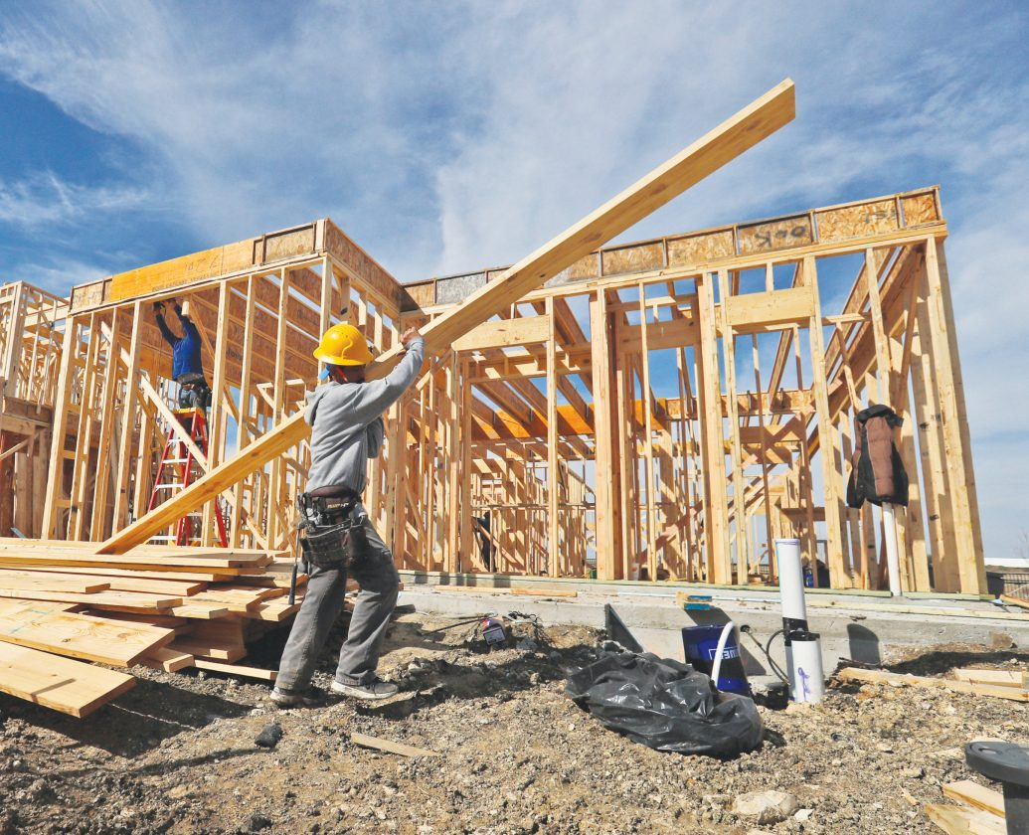
A Time To Build Up
1 Corinthians 3:6
“I planted, Apollos watered, but God was causing the growth. So then neither the one who plants nor the one who waters is anything, but God who causes the growth.”
1 Corinthians 3:11
“For no man can lay a foundation other than the one which is laid, which is Jesus”
1 Thessalonians 5:11
“Therefore encourage one another and build up one another, just as you also are doing.”
Ecclesiastes 3:3

Slide 7
A Time Of
Weeping & Laughing
Ecclesiastes 3:4
“A time to weep and a time to laugh;
A time to mourn and a time to dance.”
Luke 10:20
“Nevertheless, do not rejoice in this, that the spirits are subject to you, but rejoice that your names are recorded in heaven.”
Romans 12:15 Rejoice with those who rejoice, and weep with those who weep.
Ecclesiastes 3:4

Slide 8
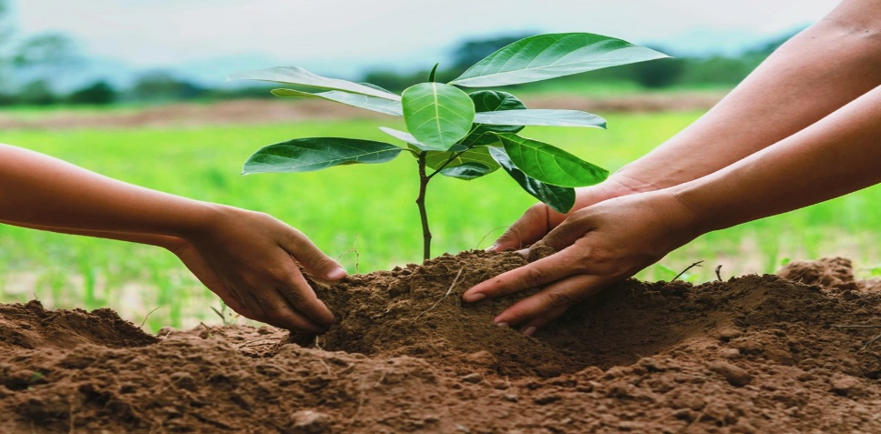
A Time To Plant
Matthew 29:18-20
“And Jesus came up and spoke to them, saying, "All authority has been given to Me in heaven and on earth. Go therefore and make disciples of all the nations, baptizing them in the name of the Father and the Son and the Holy Spirit, teaching them to observe all that I commanded you; and lo, I am with you always, even to the end of the age.”
1 Corinthians 15:1-2
“Now I make known to you, brethren, the gospel which I preached to you, which also you received, in which also you stand, by which also you are saved, if you hold fast the word which I preached to you, unless you believed in vain.”
Ecclesiastes 3:2
Notes:
“Honor father and Mother” is the 5th commandment not 1st. Paul probably meant a command that was of primary importance to children. Obeying and honoring parents would require a disciplined life, which would lead to a long and happy life.

Slide 9
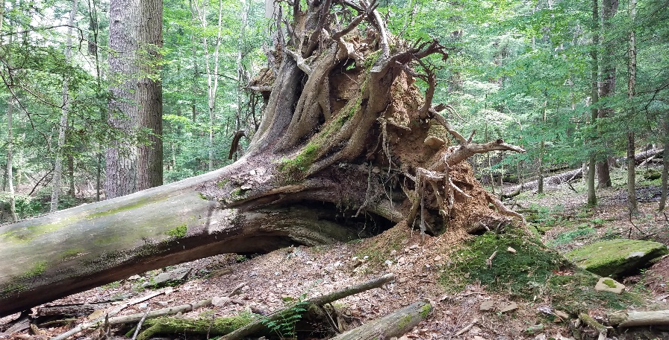
A Time To Uproot
John 15:6
“If anyone does not abide in Me, he is thrown away as a branch and dries up; and they gather them, and cast them into the fire and they are burned.”
Matthew 15:13
“But He answered and said, "Every plant which My heavenly Father did not plant shall be uprooted.”
Galatians 1:9
“As we have said before, so I say again now, if any man is preaching to you a gospel contrary to what you received, he is to be accursed!
Matthew 13:40
So just as the tares are gathered up and burned with fire, so shall it be at the end of the age.
Ecclesiastes 3:2
Notes:
“

Slide 10
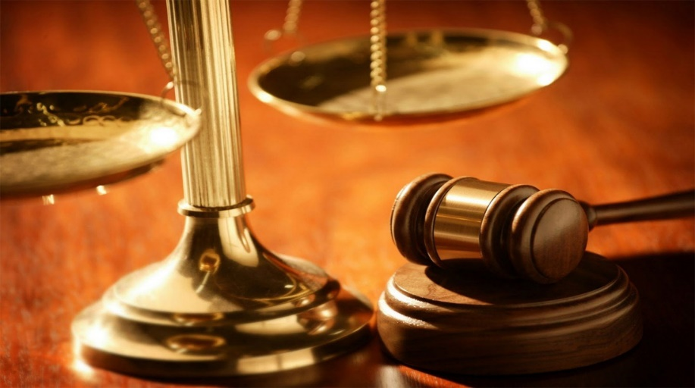
A Time Of
Judgment
2 Corinthians 5:10
“For we must all appear before the judgment seat of Christ, so that each one may receive what is due for what he has done in the body, whether good or evil.”
Romans 14:12
“So then each of us will give an account of himself to God.”
1 Peter 4:17
“For it is time for judgment to begin at the household of God; and if it begins with us, what will be the outcome for those who do not obey the gospel of God?”
Ecclesiastes 3:1-8

Slide 11
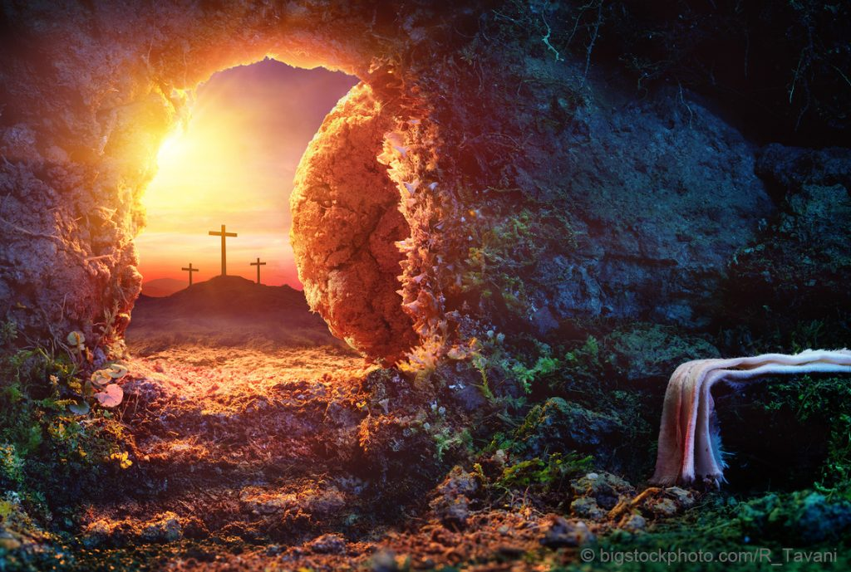
A Time Of
REBIRTH
John 3:3
“Jesus answered him, ‘Truly, truly, I say to you, unless one is born again he cannot see the kingdom of God.’”
1 Peter 1:3-5
“Blessed be the God and Father of our Lord Jesus Christ! According to his great mercy, he has caused us to be born again to a living hope through the resurrection of Jesus Christ from the dead, to an inheritance that is imperishable, undefiled, and unfading, kept in heaven for you.”
Acts 2:38
“And Peter said to them, ‘Repent and be baptized every one of you in the name of Jesus Christ for the forgiveness of your sins, and you will receive the gift of the Holy Spirit.’”

Slide 12
Navigating The River
Of Time
“He has made everything beautiful in its time. Also, he has put eternity into man's heart, yet so that he cannot find out what God has done from the beginning to the end.”
- Ecclesiastes 3:11

